Slide 2
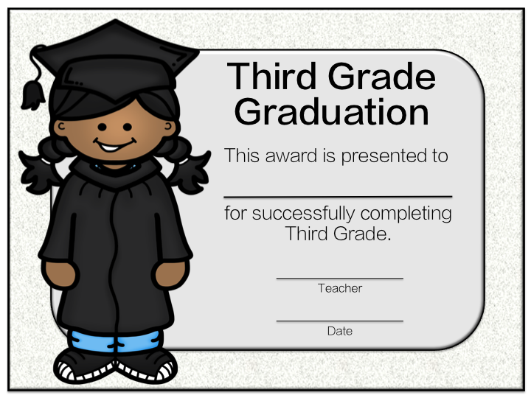
Write Student’s Name
Write Your Name
(MM/DD/YYYY)

Slide 3
Write Student’s Name
Write Your Name
(MM/DD/YYYY)

